Slide 1
DATA DRIVEN rendering
DEV4 day5-8

Slide 2

The importance of renderers
KD/OCT TREE, Node Hierarchy
GAME TOOLS, EDITOR
Level/NPC/Terrain/FX Renderer
Input, Physics, Audio
Game Engine
Game Specific Systems
GAME DATA/SCRIPT
Gameplay/Script Execution
Game Executable

Slide 3
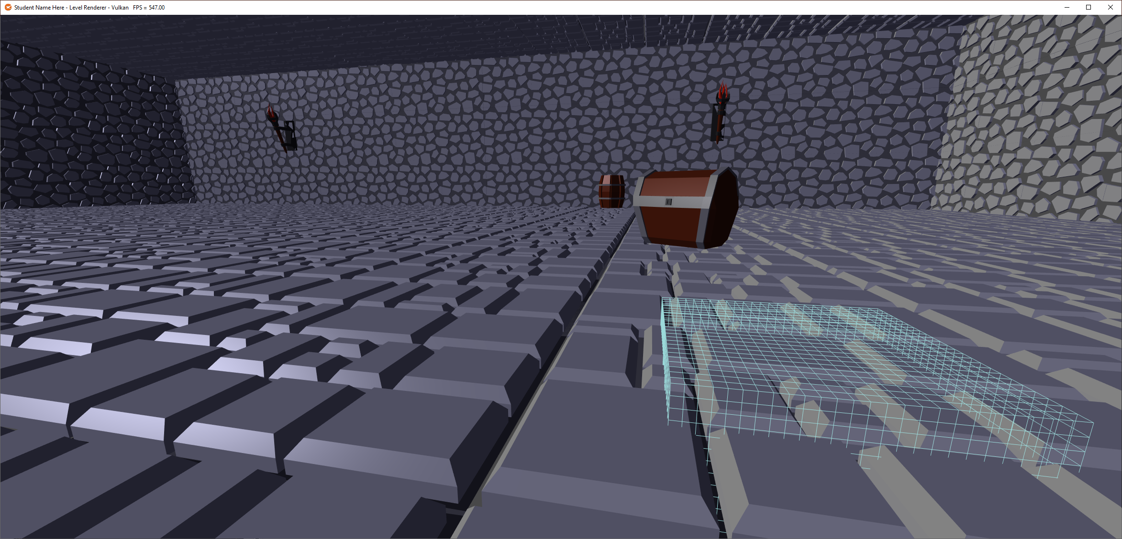
The level renderer

Slide 4
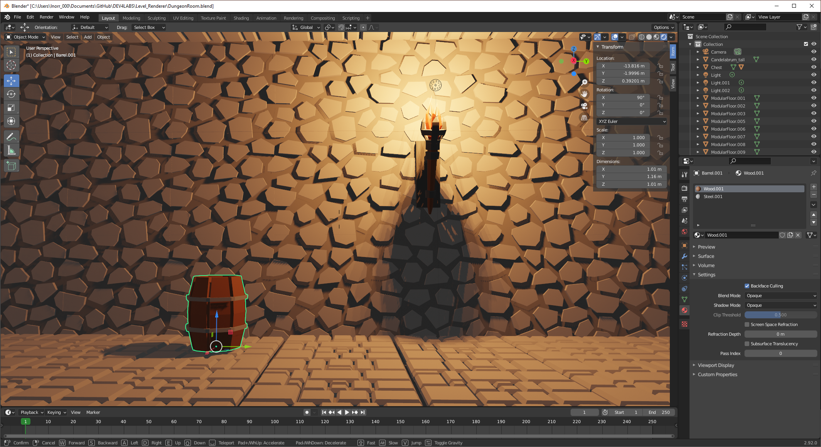
THE LEVEL EDITOR

Slide 5
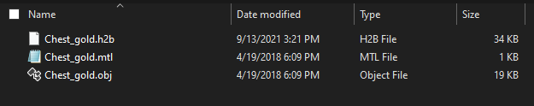
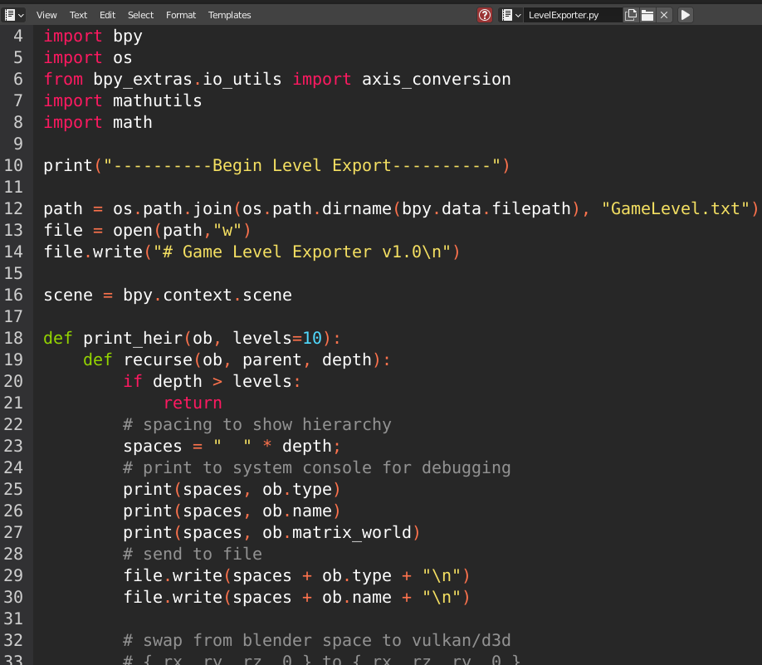
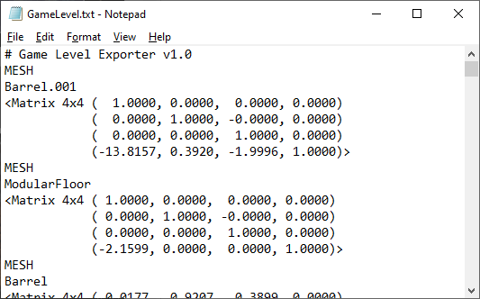
THE LEVEL DATA

Slide 6
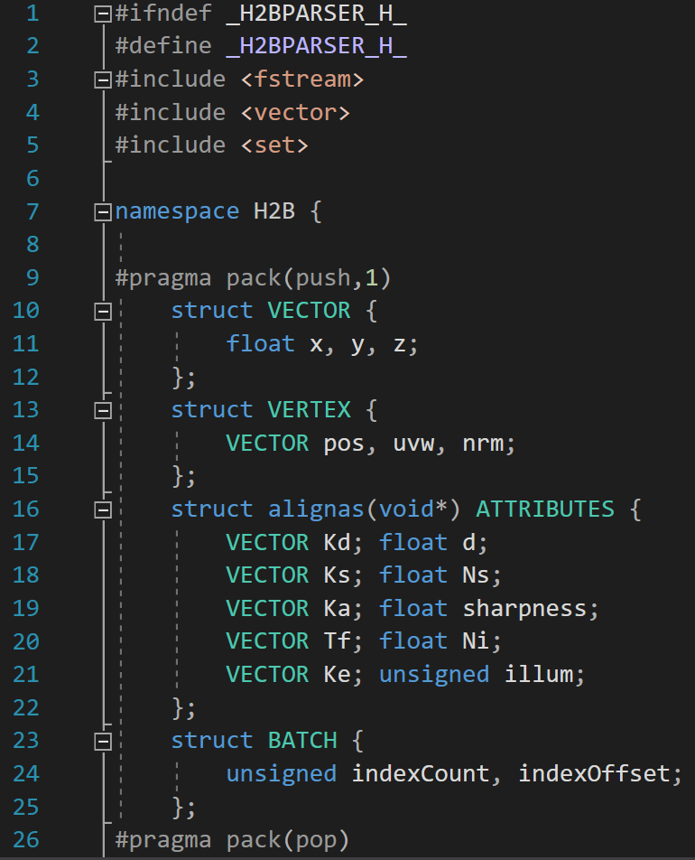
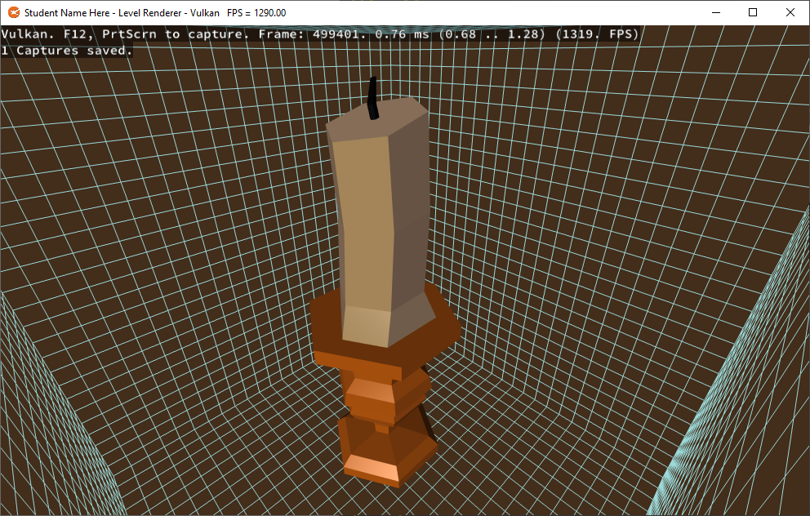
THE LEVEL tools & Executable

Slide 7

building & exporting our first level

Slide 8
Object oriented approach
Create “Model” class:
Has a vertex/index buffer, A Parser, Its own SHADER_MODEL_UNIFORMS (Lab4).
For each model in the Level, Load data from .h2b file, populate uniforms.
Adapt Lab4 Renderer to have a larger storage buffer to hold all uniforms.
Use a “Model_ID” in addition to your Mesh_ID to pick the right array slot.
Transfer all matrix uniforms each frame before drawing. (many duplicates)
Loop for each model, then each model’s mesh, switching vertex/index buffers.

Slide 9
Object oriented considerations
pros
cons
Easier for those used to OO code
Models are “self-contained” to a degree
Requires little pre-planning
Everything is assumed to be one-by-one
Arguably the fastest to start with
Fewest adjustments to lab4 shaders
Poor performance ceiling
Lack of simple instancing support
Memory Inefficient
Significant amounts of duplicated data
Generally Inflexible design
Data and Logic are coupled

Slide 10
Data oriented approach
Load All Unique Models into a “Level_Data” class:
One array each for all combined Vertices, Indices, Material, Meshes, etc...
Each model encountered is recorded as an Instance.
Only new models copy data to the arrays, each instance is a collection of offsets & size.
Upload all unique mesh/material data to one storage buffer.
Create separate uniform buffers for scene uniforms and instance matrices.
Use the offset/instance features of the API to draw each batch only once.

Slide 11
DATA oriented considerations
pros
cons
Strong Performance
Instancing makes a massive difference
Memory Efficient
Only unique data is uploaded
More Flexible design
Data and Logic are de-coupled
Everything is somewhere in an array
Confusing when things go wrong
Requires LOTS of pre-planning
You need to organize your data well
Significant API familiarity required
Might as well start fresh or with lab3

Slide 12
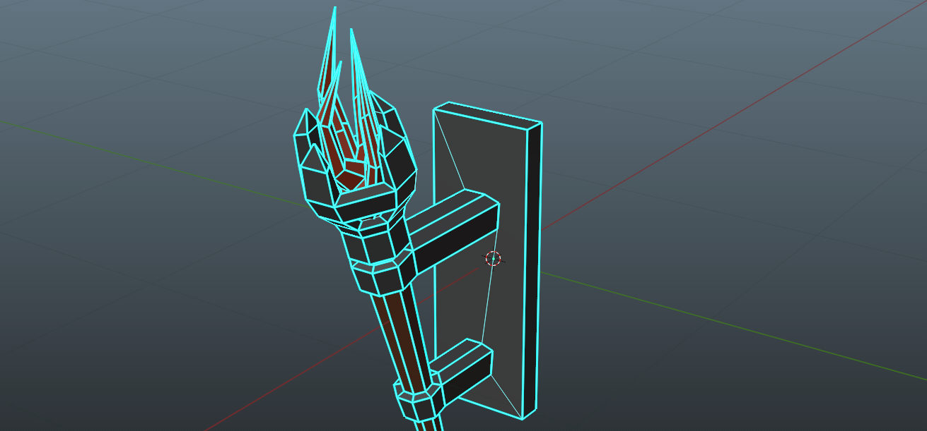
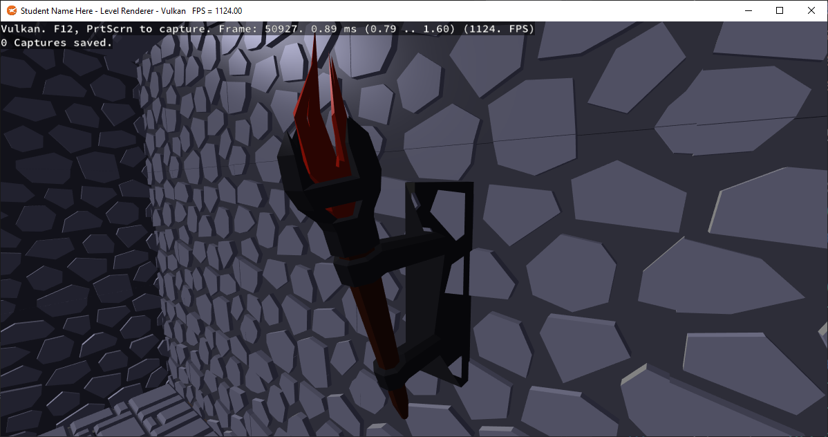
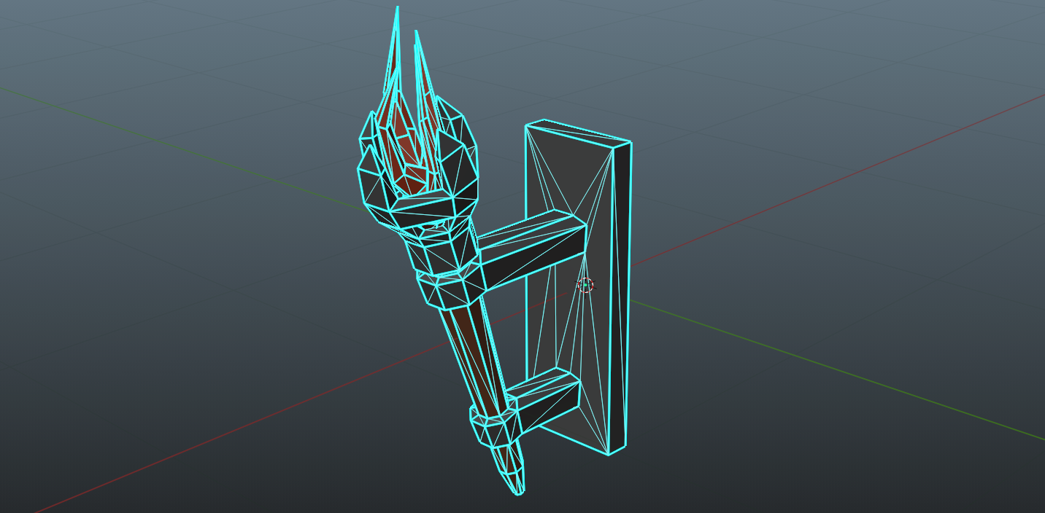
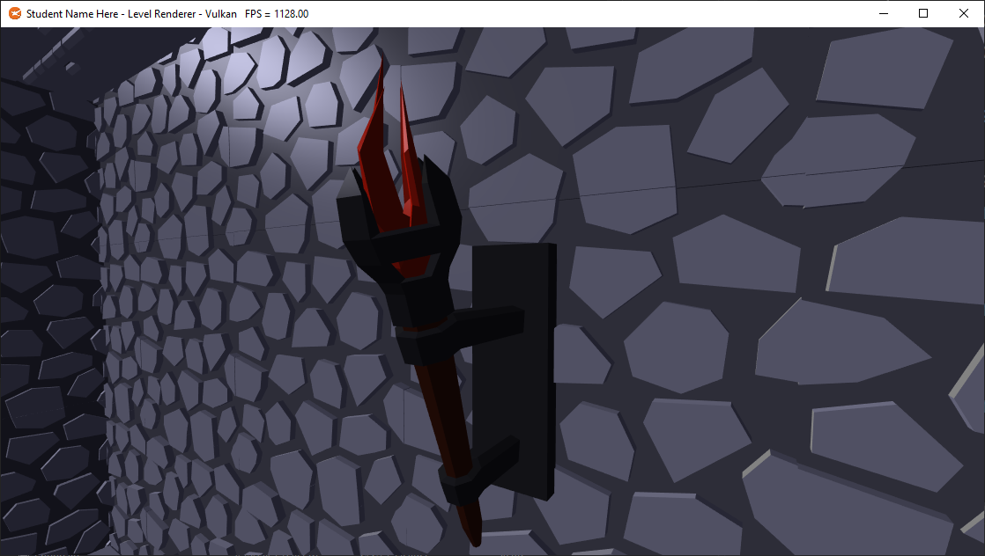
Lessons learned
N-POLYS
TRIANGLES

Slide 13
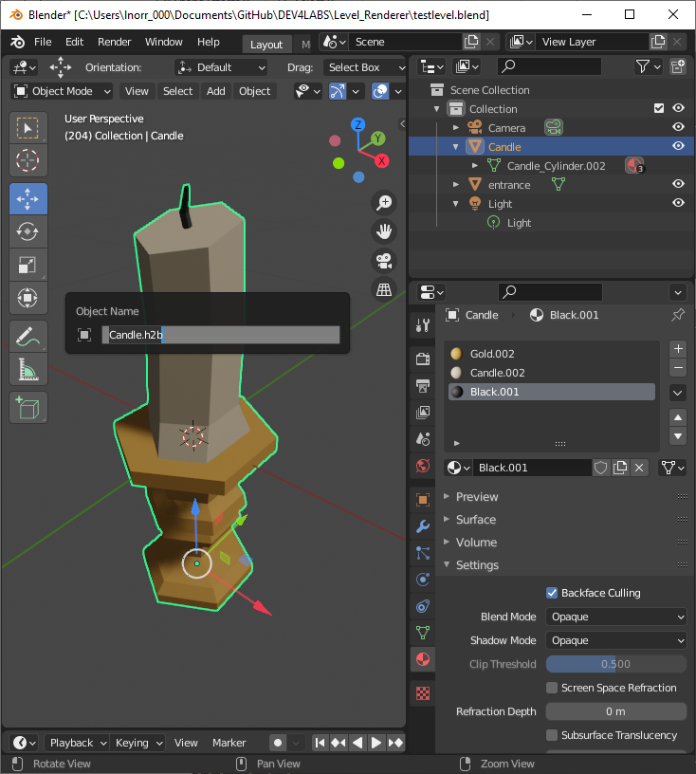
Remember
Triangulate your models before use
Blender has the Y and Z axis swapped
OBJ files don’t retain their file name when imported, rename them for export
Blender has a first-person view + gravity, great for walking the level
You can preview lights & materials by switching the viewport shading
Back-face culling is OFF by default in Blender but ON by default in most APIs

Slide 14
Q

